Slide 1
Discrete Structures
Algorithmic complexity
Prof Engr Faiz ul haque Zeya
Slides from Young. CS 331 D&A of Algo.
Young
CS 331 D&A of Algo.
Topic: Introduction

Slide 2
Introduction
Algorithms
Order
Analysis of Algorithm
Some Mathematical Background
Young
CS 331 D&A of Algo.
Topic: Introduction

Slide 3
What is an algorithm?
A simple, unambiguous, mechanical procedure to carry out some task.
Why algorithm instead of program?
Writing an algorithm is simpler (we don’t need to worry about the detailed implementation, or the language syntax).
An algorithm is easier to read than a program written in, for instance, C.
Young
CS 331 D&A of Algo.
Topic: Introduction

Slide 4
How to represent an algorithm?
Give a description in your own language, e.g. English, Spanish, …
2. Pseudo code
3. Graphical
Young
CS 331 D&A of Algo.
Topic: Introduction

Slide 5
Example – multiplying two positive integers A and B
For example: 45*19
Usually:
45
19 (x
405
45 (+
855
Topic: Introduction
Young
CS 331 D&A of Algo.

Slide 6
A different algorithm:
Multiplier Multiplicand Result
(A/2) (B*2) (pick numbers in column 2 when the corresponding number under the multiplier is odd)
45 19 19
22 38
11 76 76
5 152 152
2 304
1 608 608 (+
855
Young
CS 331 D&A of Algo.
Topic: Introduction

Slide 7
An instance of a problem is a specific assignment of values to the parameters.
This algorithm can be used for multiplying any two positive integers, we say that (45, 19) is an instance of this problem. Most problems have infinite collection of instances.
It’s ok to define the domain (i.e. the set of instances) to be considered, and the algorithm should work for all instances in that domain.
Although the above algorithm will not work if the first operand is negative, this does not invalidate the algorithm since (-45, 19) is not an instance of the problem being considered.
Young
CS 331 D&A of Algo.
Topic: Introduction

Slide 8
Order:
Usually we use the frequency count to compare algorithms.
Consider the following 3 programs:
(a) (b) (c)
x ← x + y for i ← 1 to n do for i ← 1 to n do
x ← x + y for j ← 1 to n do
end x ← x + y
end
end
The frequency count of stmt x ← x + y is 1, n, n².
No matter which machine we use to run these programs, we know that the execution time of (b) is n times the execution time of (a).
Young
CS 331 D&A of Algo.
Topic: Introduction

Slide 9


Big-O notation:
Def f(n) = O(g(n)) if and only if ∃ 2 positive constants c and n₀,
such that
|f(n)| ≤ c • |g(n)| ∀ n ≥ n_{0.}
So, g(n) actually is the upper bound of f(n).
n₀
Figure 1. Illustrating “big O”
Young
CS 331 D&A of Algo.
Topic: Introduction

Slide 10
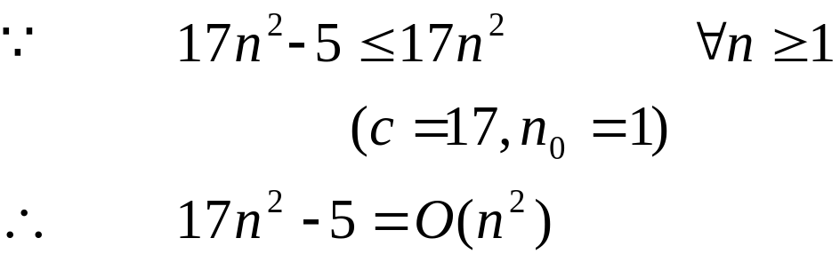
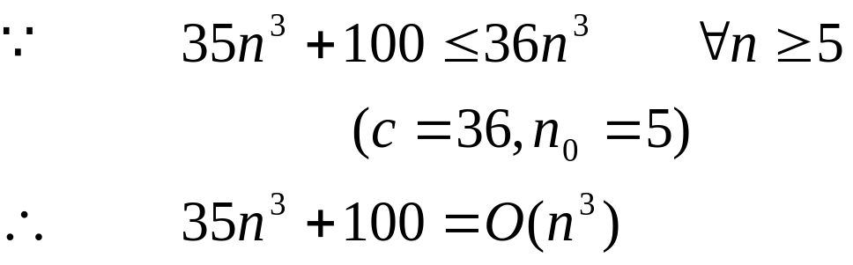
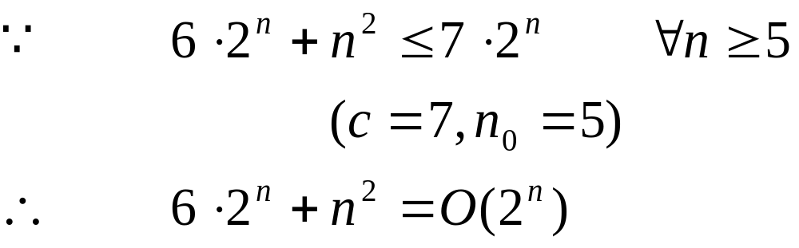
Examples:
  Is 17 n² – 5 = O(n²)?
  Is 35 n³ + 100 = O(n³)?
  Is 6 • 2^{n} + n² = O(2^{n})?
Young
CS 331 D&A of Algo.
Topic: Introduction

Slide 11
Complexity classes
f(n)
n!
2^{n}
n³
n²
n log n
n (linear time)
log n
n
Figure 2. Growth rates of some important complexity classes
Young
CS 331 D&A of Algo.
Topic: Introduction

Slide 12
Assume that we have a machine that can execute 1,000,000 required operations per sec
 | Algorithm 1 | Algorithm 2 | Algorithm 3 | Algorithm 4 | Algorithm 5
Frequency count | 33n | 6nlogn | 13n² | 3.4n³ | 2^{n}
n=10 n=10,000 | < 1 sec < 1 sec | < 1 sec < 1 sec | < 1 sec 22 min | < 1 sec 39 days | < 1 sec many many centuries
Table 1. Execution time for algorithms with the given time complexities
Young
CS 331 D&A of Algo.
Topic: Introduction

Slide 13
Note:
log n
n(linear)
n log n polynomial time (easy or tractable)
n²
n³
2^{n}
n!
exponential time (hard or intractable)
Young
CS 331 D&A of Algo.
Topic: Introduction

Slide 14
Whether your program is the best or not?
(Comparing algorithms)
The problem: Counting the number of 1’s in a n-bit string algorithms:
  c ← 0;
for i ← 1 to n do
if b_{i} = 1 then c ← c+1;
Complexity: T(n) = O(n)
Young
CS 331 D&A of Algo.
Topic: Introduction

Slide 15
Assume B = b_{n}b_{n-1}…b₂b₁
c ← 0;
while B ≠ 0 do
c ← c+1;
B ← B ∧ (B –1 ); ( Note that ∧ is “logical and” )
Complexity: T(n) = O( # of 1’s)
example: B = 100011
c ← 1 100011 B
∧) 100010 B-1
c ← 2 100010 B’
∧) 100001 B’-1
c ← 3 100000 B’’
∧) 011111 B’’-1
000000 B’’’
Young
CS 331 D&A of Algo.
Topic: Introduction

Slide 16
Can we do it in log n time?
  B = 11010001
 | b₈ b₇ b₆ b₅ b₄ b₃ b₂ b₁
B | 1 1 0 1 0 0 0 1
Odd Shift even to right B¹ = B_{odd} + B_{even} | 1 1 0 1 1 0 0 0 10 01 00 01
Odd Shift even to right B² = B_{odd} + B_{even} | 01 01 10 00 0011 0001
Odd Shift even to right B³ = B_{odd} + B_{even} | 0001 0011 0100
Young
CS 331 D&A of Algo.
Topic: Introduction

Slide 17
Idea:
11010001
1101 0001
==> T(n) = O(logn)
11 01 00 01
1 1 0 1 0 0 0 1
4
3
1
2
1
0
1
Note:
- The familiar machine that we used can only execute one
operation in each step ⇒ sequential machine.
This stated algorithm requires the machine to have more than
one operation done in each step ⇒ parallel machine
Young
CS 331 D&A of Algo.
Topic: Introduction

Slide 18

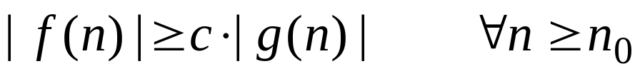


Ω notation
Def iff ∃ two positive constants c and n₀,
such that
So, g(n) is the lower bound of f(n).
n₀
Figure 3. Illustrating Ω
Young
CS 331 D&A of Algo.
Topic: Introduction

Slide 19

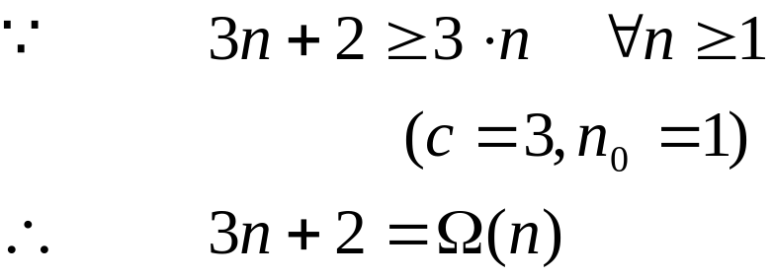

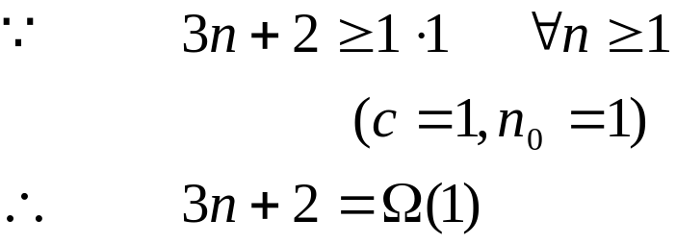

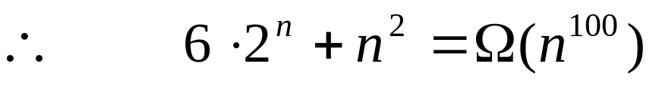
Examples:
  Is ?
  Is ?
        value of n₀
  Is ?
  When n is bigger, 2^{n} will grow faster than n¹⁰⁰. ( Yes, you can find n₀ )
Young
CS 331 D&A of Algo.
Topic: Introduction

Slide 20



Θ notation
Def iff ∃ three positive constants, c₁, c₂, n₀ ,
such that
n₀
Figure 4. Illustrating Θ
Young
CS 331 D&A of Algo.
Topic: Introduction

Slide 21
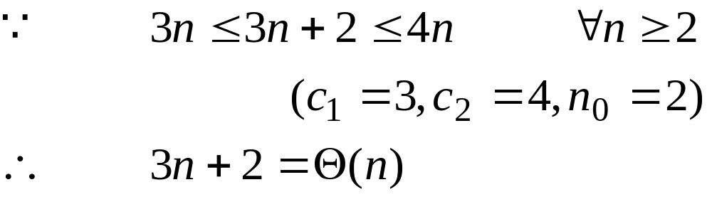
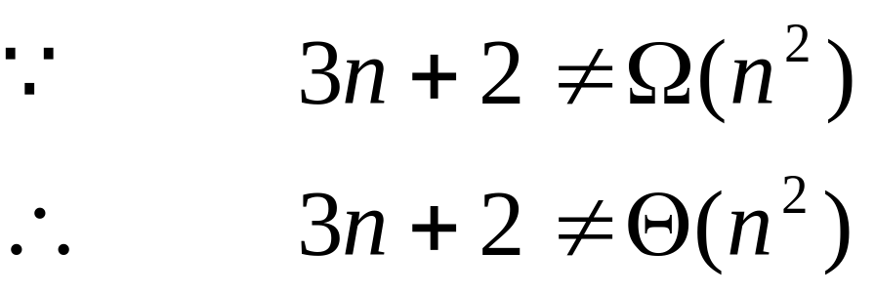
Examples:
  Is 3n + 2 = Θ(n)?
  Is 3n + 2 = Θ(n²)?
Young
CS 331 D&A of Algo.
Topic: Introduction

Slide 22

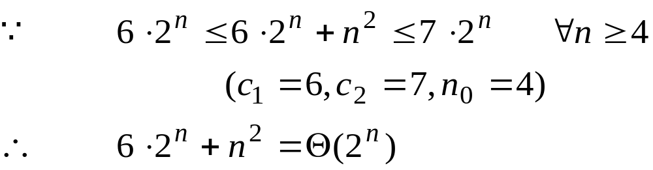

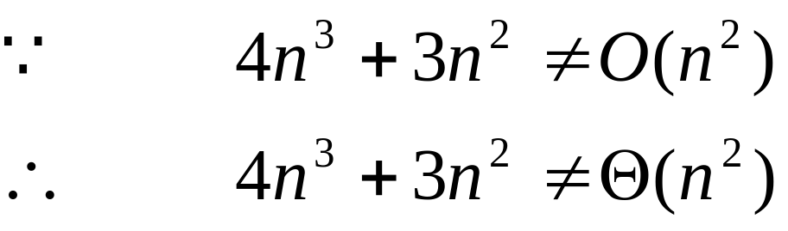
Is ?
Is ?
Young
CS 331 D&A of Algo.
Topic: Introduction

Slide 23









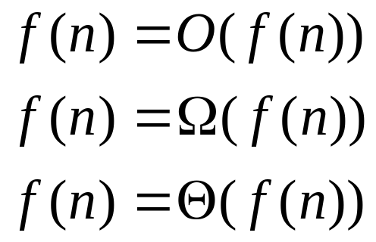
Property of Order
Transitive:
If and then
If and then
If and then
Reflexive:
Young
CS 331 D&A of Algo.
Topic: Introduction

Slide 24
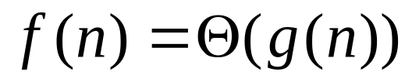

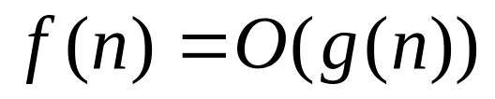
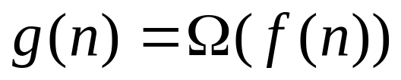
Symmetric:
iff
iff
Young
CS 331 D&A of Algo.
Topic: Introduction

Slide 25
Analysis of Algorithms
Best Case, Worse Case Analysis
The problem:
Sort n keys in nondecreasing sequence.
Solving strategy:
Insertion sort – insert the i^{th} item into a sorted list of length (i – 1) by looking at numbers one at a time, ∀ i >1.
Example: sort 3,5,4,1
step 1 step 2 step 3 step 4
3 3 3 1
5 5 4 3
4 4 5 4
1 1 1 5
Young
CS 331 D&A of Algo.
Topic: Introduction

Slide 26
Algorithm:
A(0) ← -maxint; // for efficient to stop the loop
for i ← 2 to n do
target ← A(i);
j ← i –1;
while (target < A(j))
A( j + 1) ← A(j);
j ← j –1;
A( j + 1) ← target;
Young
CS 331 D&A of Algo.
Topic: Introduction

Slide 27
Analysis:
Best Case performance is Θ(n) or Ω(n), but not Ω(n²) since insertion sort runs in Θ(n) when the input is sorted.
Worst Case performance is Θ(n²) or O(n²)
The running time of insertion sort is between Ω(n) to O(n²)
The running time is bound to O(n²)
Young
CS 331 D&A of Algo.
Topic: Introduction

Slide 28
Average Case Analysis
The problem:
Is the key x in the array S of n keys?
Solving strategy:
Sequential search
Young
CS 331 D&A of Algo.
Topic: Introduction

Slide 29
Algorithm:
Procedure search ( n, S, x, location) // n is total # of keys,
S is an array,
x is the key,
location is output parameter
begin
location ← 1;
while (location ≤ n) and (S[location] ≠ x)
location ++;
if location > n location ← 0;
end;
Young
CS 331 D&A of Algo.
Topic: Introduction

Slide 30
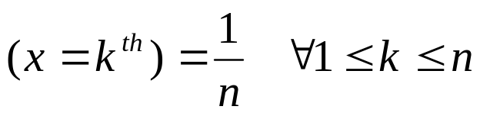
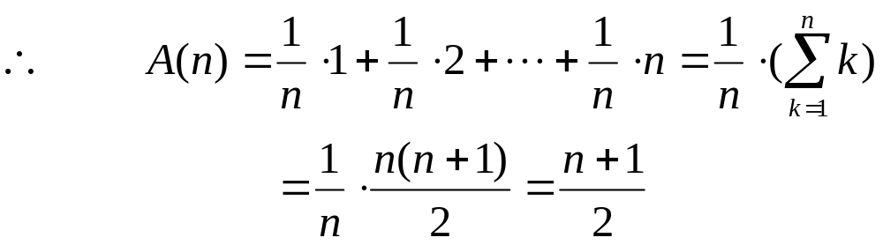
Average Case Analysis:
When ‘x is in the array’, we assume that
Probability prob
  When x = k^{th}, # of key comparisons = k
  about half array is searched.
Young
CS 331 D&A of Algo.
Topic: Introduction

Slide 31
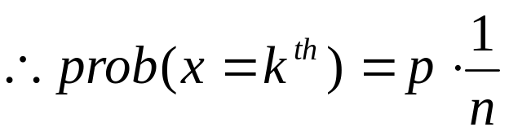
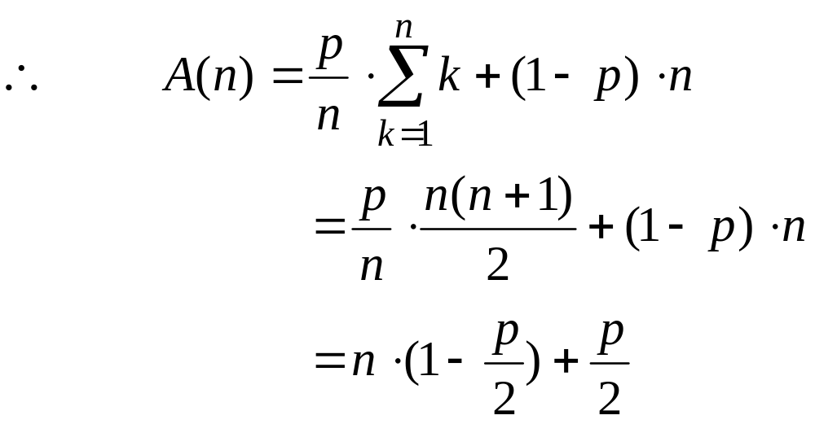
When ‘x may not be in the array’
  Assume prob (x in array) = p,
  prob (x not in array) = 1 – p, and it takes
  n comparisons to know that ‘is not in the array’
Young
CS 331 D&A of Algo.
Topic: Introduction

Slide 32
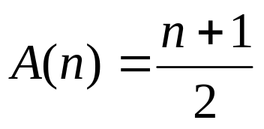
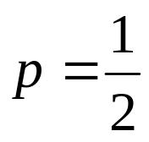
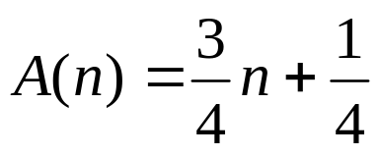
If p = 1, (as calculated in case (1))
If , (about ¾ of the array is searched)
Young
CS 331 D&A of Algo.
Topic: Introduction

Slide 33
Design of Algorithms
Divide-and-Conquer
Greedy
Dynamic Programming
Backtracking & Branch-and-Bound
Young
CS 331 D&A of Algo.
Topic: Introduction

Slide 34
Some mathematical background
Definition. Log_{b} x = y if b ^{y} = x b > 1
Log_{b} is a strictly increasing function,
∴if x₁ < x₂ then Log_{b} x₁ < Log_{b} x₂ .
Log_{b} is a one-to-one function,
if Log_{b} x₁ = Log_{b} x₂ then x₁ = x₂ .
Log_{b} 1 = 0 ∀b
Log_{b} xª = a • Log_{b} x
Log_{b}(x₁ • x₂) = Log_{b} x₁ + Log_{b} x₂
Young
CS 331 D&A of Algo.
Topic: Introduction

Slide 35
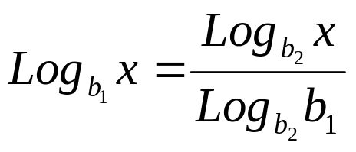
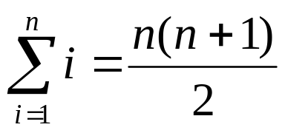
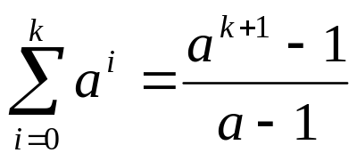
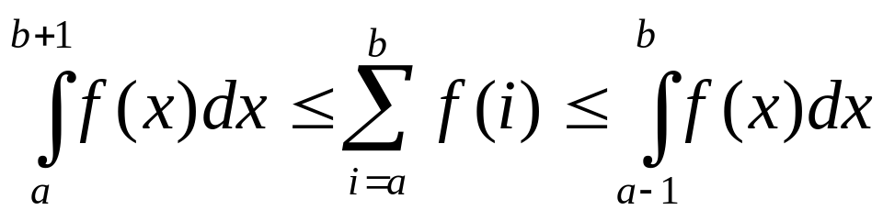
x₁^{Logb x2} = x₂^{Logb x1}
to convert from one base to another,
sum of consecutive integers
geometric sums
Suppose f is a continuous, decreasing function, a, b are integers,
then
Young
CS 331 D&A of Algo.
Topic: Introduction

Slide 36
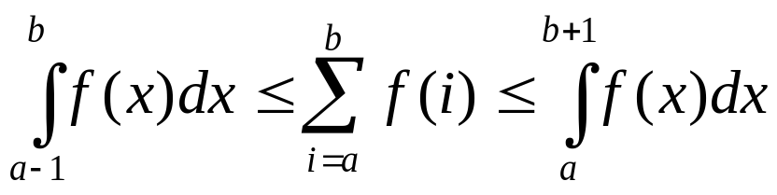
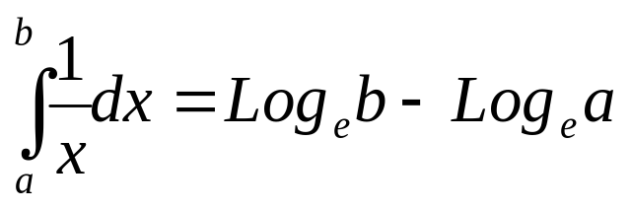
Suppose f is a continuous, increasing function, a, b are integers,
then
Note:
Log₂ = Lg
Log_{e} = Ln
Young
CS 331 D&A of Algo.
Topic: Introduction

